Slide 1
Predicting Churn: Leveraging Machine Learning to Bolster Customer Retention
Team Members: Henry Petrelli, henry.petrelli@torontomu.ca
Jocelyn John Mascarenhas, Jmascarenhas@torontomu.ca
Syed Ahsan Sirat, ssirat@torontomu.ca
Notes:
Title slide

Slide 2
Introduction
Problem Statement The goal of this project was to develop a predictive model to classify customer churn accurately. The dataset contained both numerical and categorical features, with an imbalanced target variable. Additionally, some columns like “Phone” and “Area Code” were irrelevant or high-cardinality, potentially introducing noise into the models. The imbalance in the churn classes made it challenging for standard models to perform well, especially in terms of recall and precision.
Our Solution: To address these challenges, we followed a structured data preparation and modeling strategy: Data Cleaning & Encoding: We encoded categorical variables such as State, Phone, Int'l Plan, VMail Plan, and Churn? using label encoding. Irrelevant columns like Phone and Area Code were removed to reduce noise. Handling Imbalanced Data: We applied SMOTE (Synthetic Minority Oversampling Technique) to resample the data, balancing the class distribution of churned vs. non-churned customers. Feature Selection: We used RFECV (Recursive Feature Elimination with Cross-Validation) with a Random Forest classifier to identify the most important features for classification. Model Training & Evaluation: We implemented and compared different classification models:Baseline Models: Decision Tree and Naive Bayes were initially trained on the original, unfiltered data. Refined Models: The same models were retrained using the resampled and feature-selected data. We used 10-fold cross-validation to ensure robust evaluation, averaging the scores across all folds.
Highlights of the Final Results: Decision Tree (after SMOTE + RFECV): Accuracy: 0.9500, Precision: 0.8700, Recall: 0.6800, F1 Score: 0.7600 Naive Bayes (after SMOTE + RFECV): Accuracy: 0.7100, Precision: 0.7100, Recall: 0.7200, F1 Score: 0.7200
Notes:
First state the problem you are addressing. For example, if your project is on Churn analysis, then give a brief explanation of it. Second, write the summary of your classification results (e.g., accuracy). Note do not clutter slides, just write bullet points. If you would like to provide further explanation, write in the notes section here.

Slide 3
Workload Distribution
Member Name | List of Tasks Performed
Jocelyn | Identify and replace missing values in the dataset Calculate the max, min, mean and std. deviation for each of the 21 attributes Identify and account for outliers Analyze the distributions of numerical attributes
Henry | Implement a decision tree classifier and evaluate results Implement a Naïve Bayes Classifier and evaluate results Employ a 10-fold cross-validation data split strategy for reliable model performance measurement Compare decision tree and Naïve Bayes models based on accuracy, precision, recall, and F1-score Generate tables and graphs to compare model results
Syed | Document and summarize findings from data preparation and predictive modeling (classification) phases - Write conclusions and recommendations based off classification results Implement SQL integration using SQLite (by storing the cleaned dataset and running queries to analyze customer churn) Format and finalize the project report by integrating the conclusions and recommendations with tables, charts, and other forms of effective visualization

Slide 4
Data Preparation
During data preprocessing, the dataset underwent several crucial steps:
Column Filtering: Retained only relevant features for classification by excluding non-informative or redundant fields like "Phone" and "Area Code".
Categorical Encoding: Converted categorical columns such as "State", "Int’l Plan", "VMail Plan", and "Churn?" into numerical format using Label Encoding, making them compatible with ML algorithms.
Class Imbalance Handling: The target class (Churn?) was imbalanced, which could lead to biased models. To resolve this, SMOTE (Synthetic Minority Oversampling Technique) was applied to balance the dataset.
Feature Selection: To avoid overfitting and improve model interpretability, Recursive Feature Elimination with Cross-Validation (RFECV) using a Random Forest classifier was used to select the most predictive features from the dataset.
Outcome: Clean, balanced, and reduced dataset ready for efficient and accurate modeling.
Notes:
Write your steps of data preparation that you performed during analysis of data in the order your performed them. For example, handling missing values, categorizing column or converting to numerical values, selecting feature, etc. If you want to show any figure/table feel free to insert but keep in mind that slides should be readable.

Slide 5
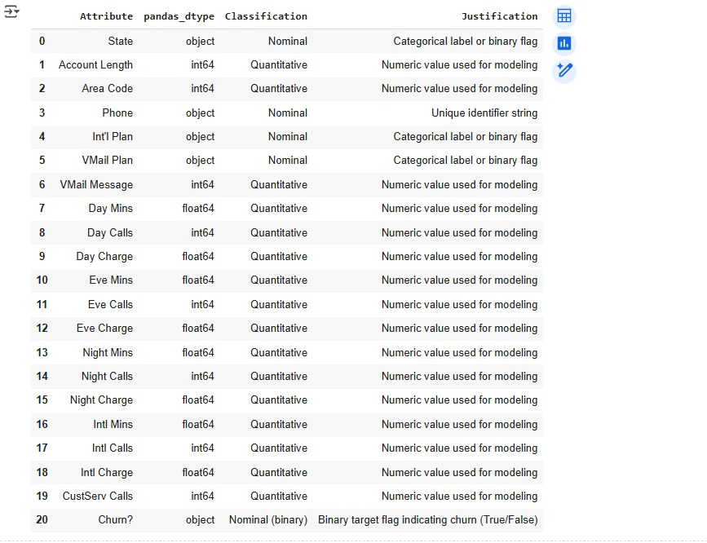
Data Attribution

Slide 6
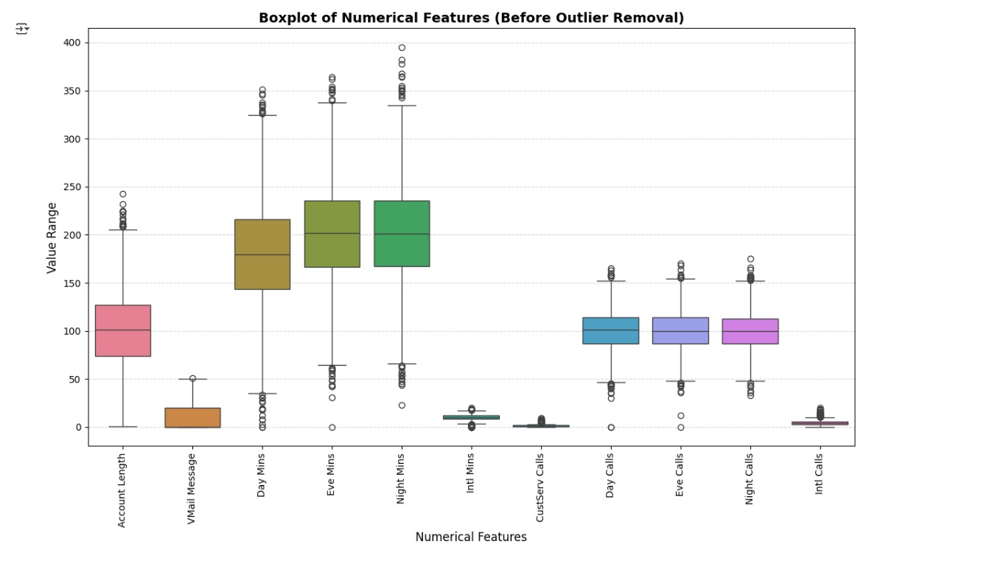
Before Running IQR Boxplot

Slide 7
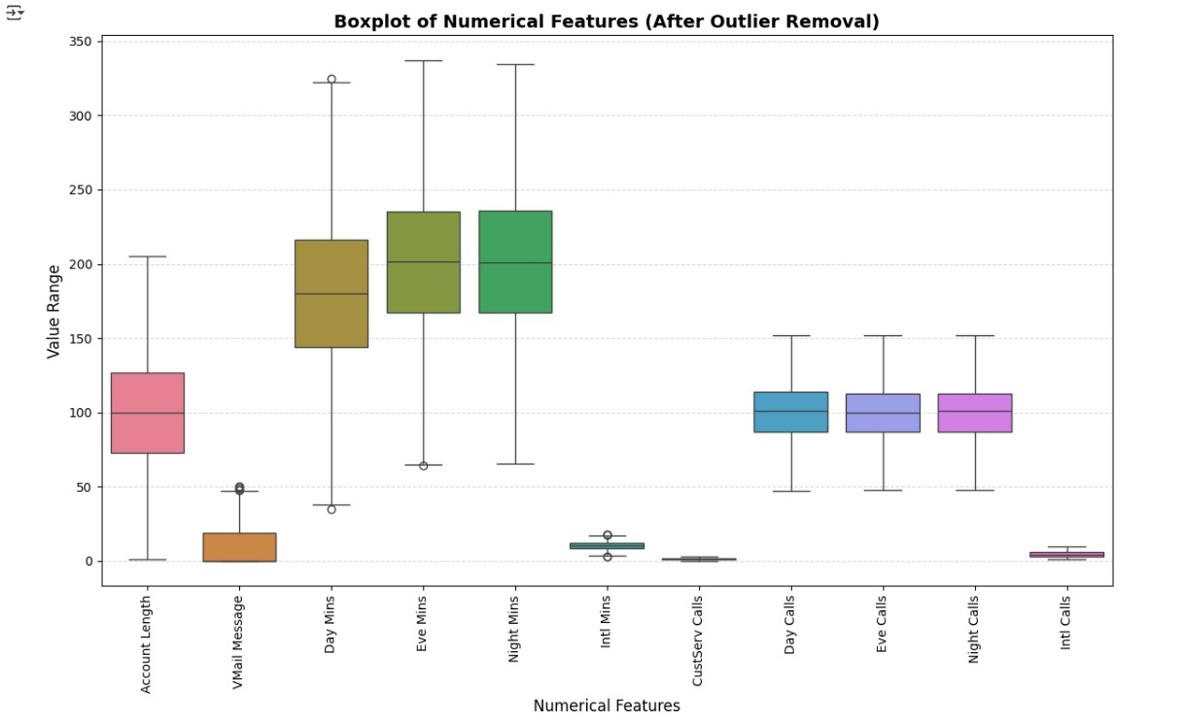
After Running IQR Boxplot

Slide 8
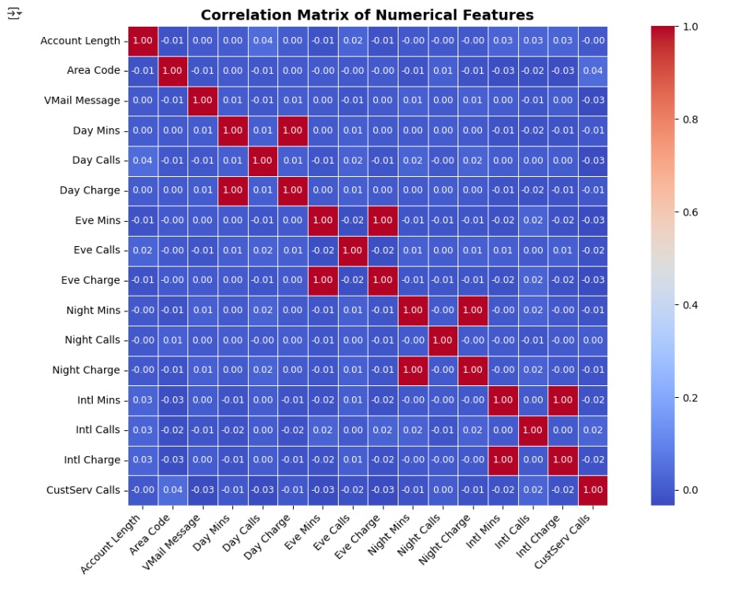
Correlation Matrix

Slide 9
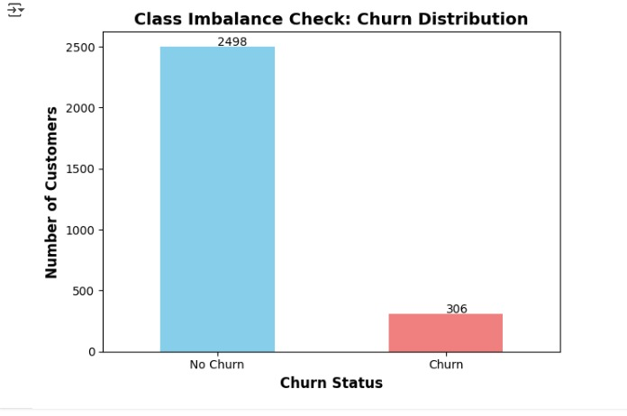
Class imbalance check

Slide 10
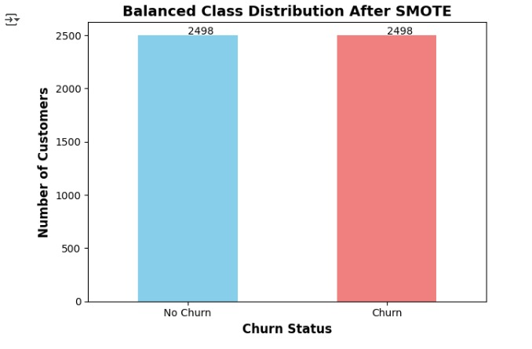
Churn status after SMOTE

Slide 11
Predictive Modeling
Two types of models were evaluated:
1. Baseline Models (Before SMOTE + Feature Selection)Trained on the original, imbalanced data.
Model | Accuracy | Precision | Recall | F1 Score
Baseline decision tree | 0.9200 | 0.6400 | 0.6800 | 0.6600
Baseline Naïve Bayes | 0.9100 | 0.5900 | 0.6900 | 0.6300
Notes:
Explain the evaluation method you used: cross validation or train-test set split
Fill out the table that will summarize your results
State which model is the best in your case. Are selected-features models they better than the baseline one?

Slide 12
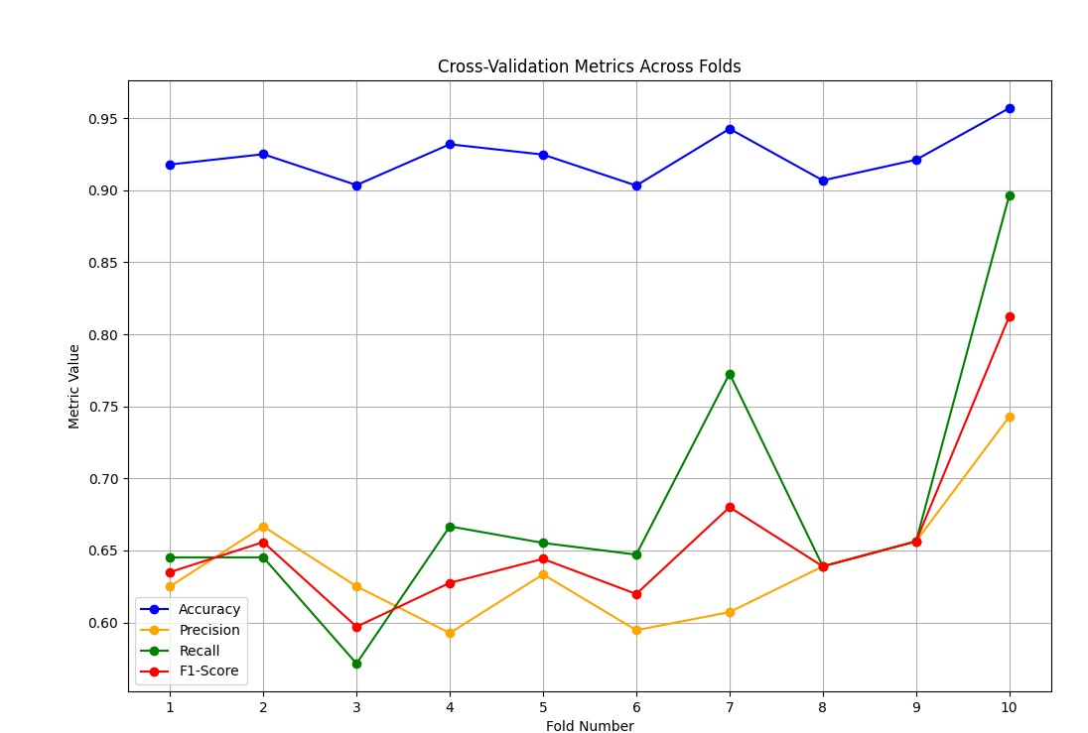
Baseline Decision Tree visualization

Slide 13
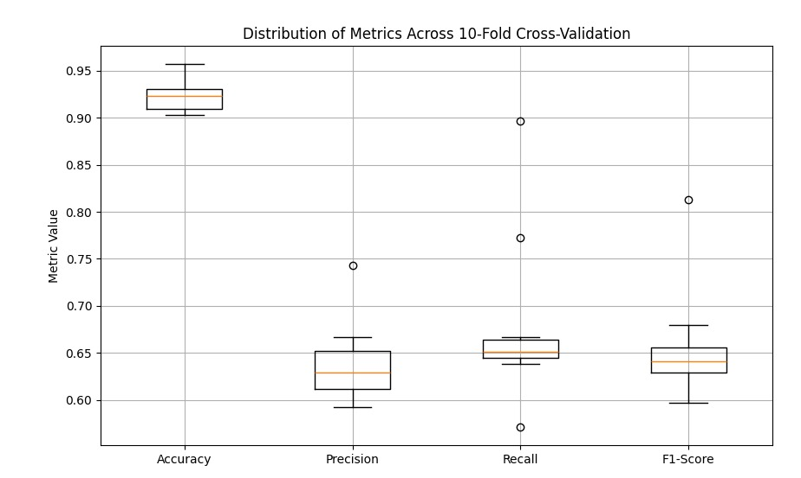
Baseline Decision Tree visualization

Slide 14
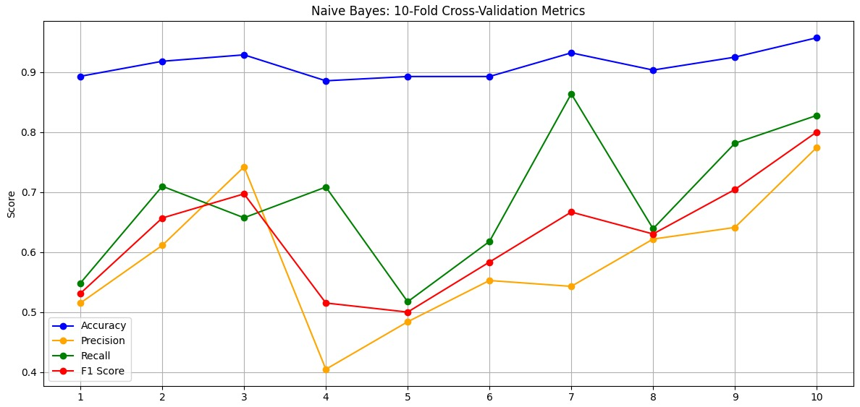
Baseline Naïve Bayes visualization

Slide 15
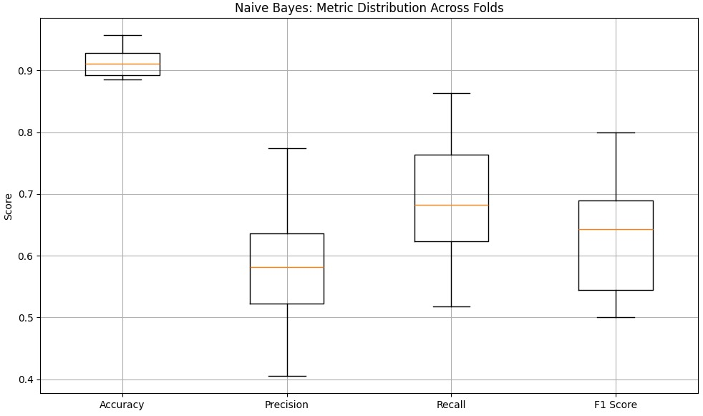
Baseline Naïve Bayes visualization

Slide 16
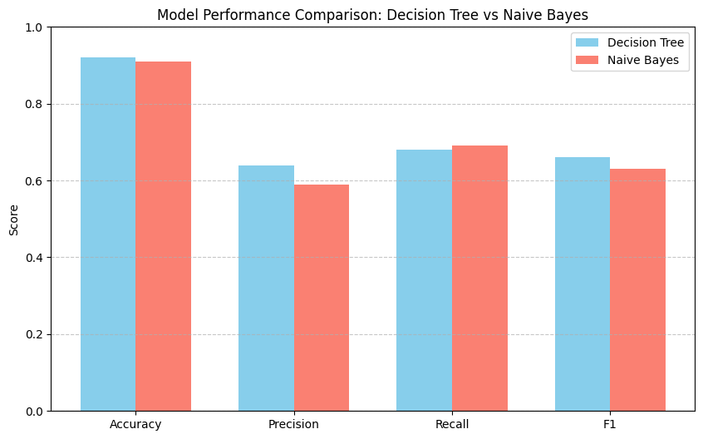
Baseline Models

Slide 17
Predictive Modeling
2. Filtered Models (After SMOTE + RFECV)Trained on a balanced dataset using SMOTE. Used only the most important features selected via RFECV. Evaluated again with 10-fold cross-validation for consistency.
Model | Accuracy | Precision | Recall | F1 Score
Decision Tree | 0.9500 | 0.8700 | 0.6800 | 0.7600
Naive Bayes | 0.7100 | 0.7100 | 0.7200 | 0.7200
Notes:
Explain the evaluation method you used: cross validation or train-test set split
Fill out the table that will summarize your results
State which model is the best in your case. Are selected-features models they better than the baseline one?

Slide 18
Filtered Models

Slide 19
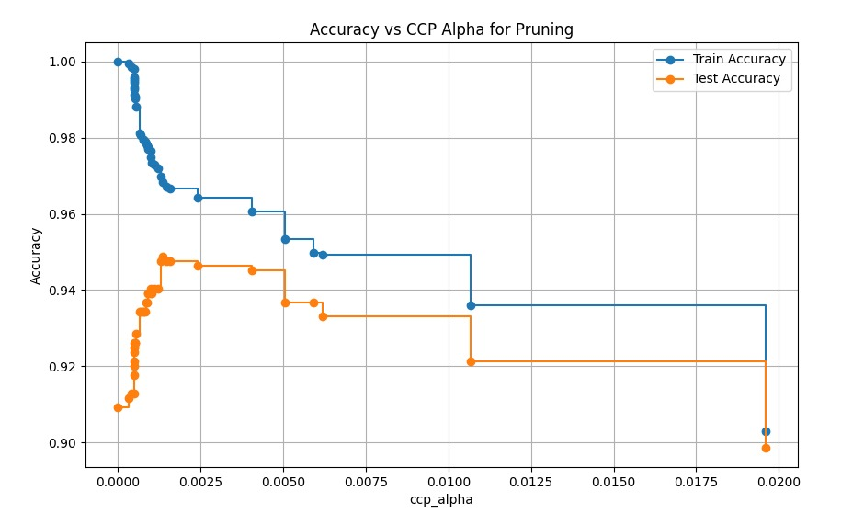

Slide 20
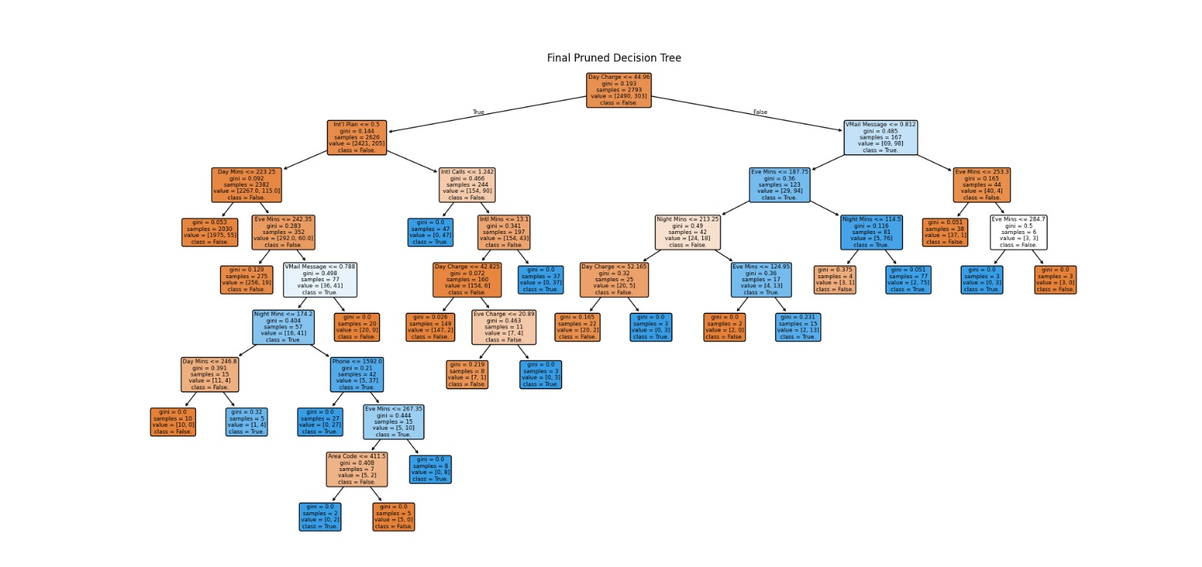

Slide 21
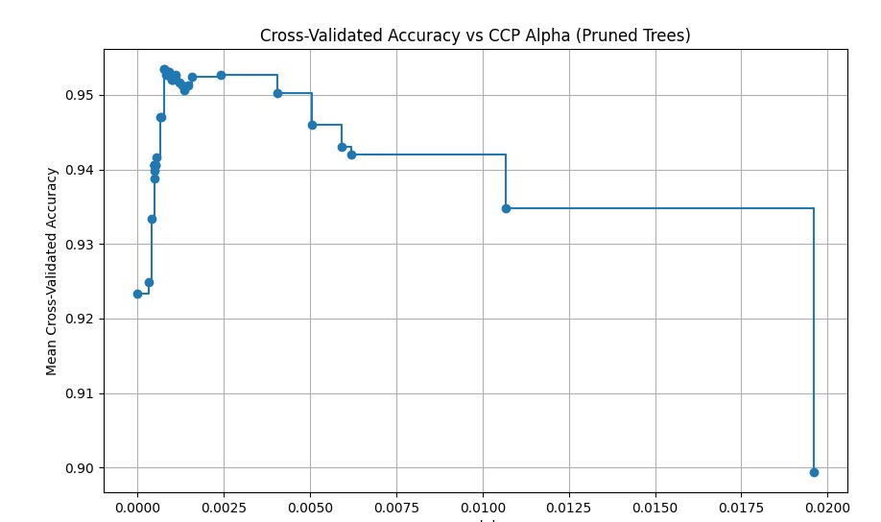

Slide 22
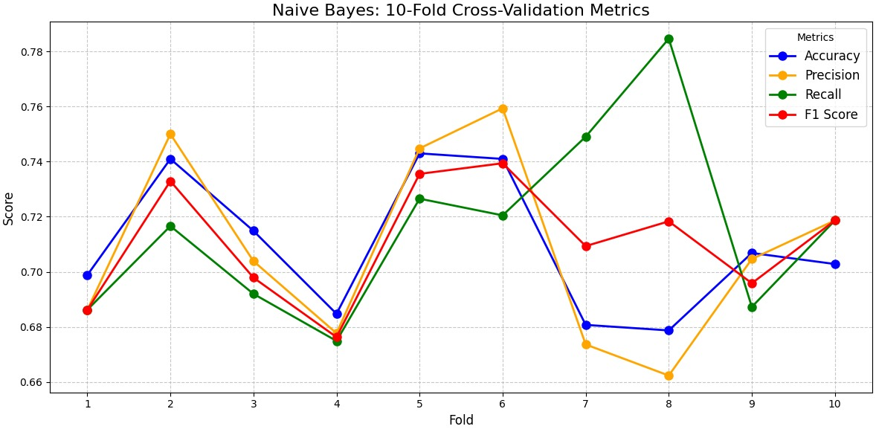

Slide 23
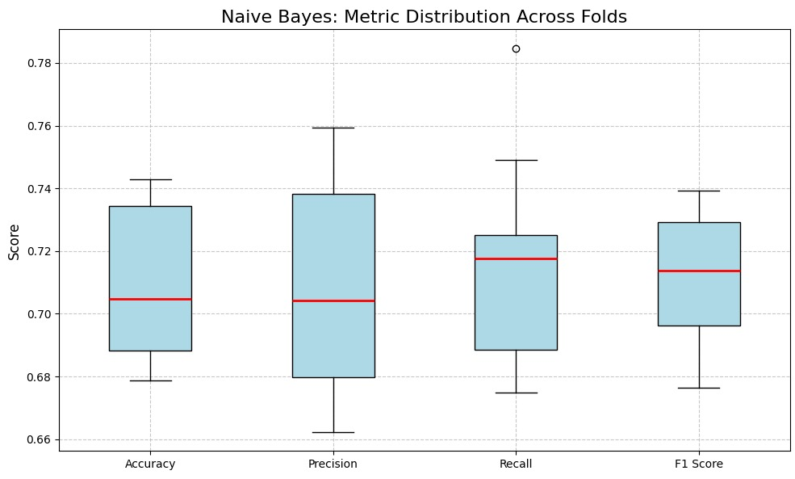

Slide 24
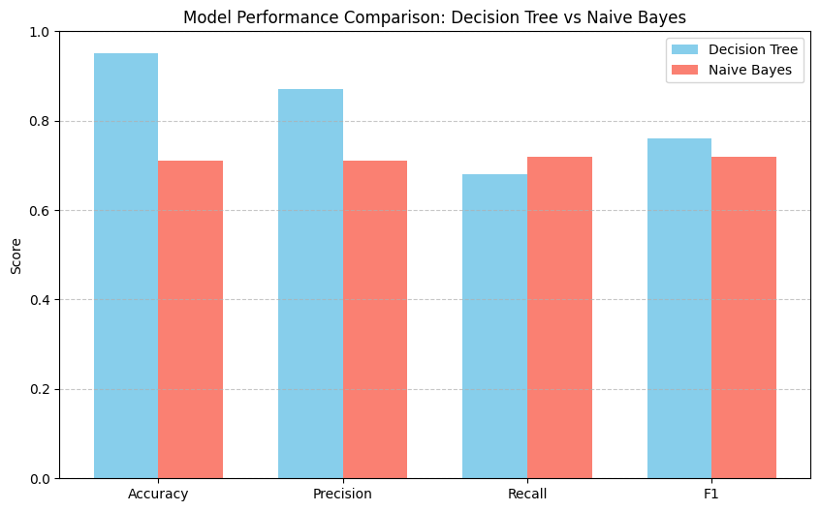
Filtered Models

Slide 25
Conclusion
Adopt the Decision Tree model trained on SMOTE-balanced and RFECV-selected data for deployment.
Integrate explain ability tools (e.g., SHAP, feature importance plots) for stakeholder trust and better understanding of churn drivers.
Monitor real-world model performance regularly to ensure stability across time.
Explore additional classifiers such as Gradient Boosting or XG Boost for potentially better performance.
Conduct domain-specific feature engineering for deeper insights and further performance gains.
Notes:
Tell the stakeholders (managers, CEOs, other data scientists, engineers) what are your final recommendation for the company.
Again the reminder, keep bullet points, figures or tables on the slide and for any additional explanation use the notes section on each slide.

Slide 26
Recommendation
Use Decision Tree as the final classifier: It provides a strong balance of performance and interpretability.
Deploy the model trained on SMOTE-balanced and feature-selected data: This ensures better results in real-world churn prediction.
Incorporate model explainability tools (like SHAP or feature importance plots) to better understand key churn indicators and support business decisions.
Monitor live model performance regularly on incoming data to ensure metrics like precision and recall remain strong.
Explore additional models (e.g., Gradient Boosting, XGBoost) for further performance enhancement.
Continue feature refinement by exploring domain-specific features (e.g., customer engagement metrics) to boost predictive power.
Notes:
Tell the stakeholders (managers, CEOs, other data scientists, engineers) what are your final recommendation for the company.
Again the reminder, keep bullet points, figures or tables on the slide and for any additional explanation use the notes section on each slide.

